Slide 1
Ceylan: A framework for building extensible and dynamic autonomic managers
Yoann Maurel
JURY |  | ²
Pr. Gaëlle CALVARY, | Présidente, | Grenoble INP
Dr. François CHARPILLET, | Rapporteur, | Inria
Dr. Roy STERRITT, | Rapporteur, | University of Ulster
Dr. Julie McCANN, | Examinatrice, | Imperial College London
Pr. Philippe LALANDA, | Directeur, | UJF Grenoble
Dr. Ada DIACONESCU, | Co-directrice, | Telecom Paris-Tech

Slide 2
A story of evolution
A long time ago, in a galaxy not so far away
  Software was easy to maintain
Software
X=2
Administrator

Slide 3


A story of evolution
And then software became
  Bigger and bigger
  Interdependent
X=2
I=1+R²
T=2
X=5+Z
U=6
Y=2+U
A=2
R=0
Administrator

Slide 4
A story of evolution
And then software became
  Bigger and bigger
  Interdependent
  Distributed, heterogeneous, dynamic
COMPLEX AND UNMAINTANABLE
X=2
H=2
L=2+3i
D=2
I=2
M=V(2)
P=2
J=2
N=t-f(2)
C=2
K=2
0=2+M
Administrator

Slide 5
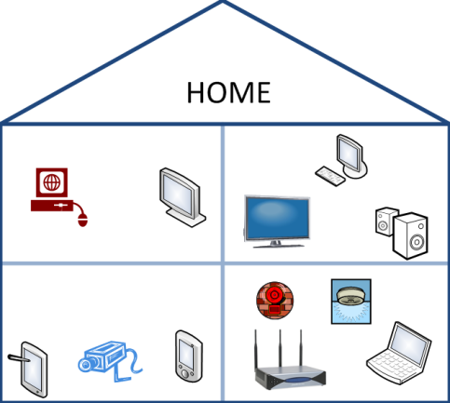


Complexity is everywhere!
Administrator
Notes:
.

Slide 6
Solution? Autonomic Computing
expert
M
A
N
A
G
E
R
Z=3
“Lower CPU consumption”
GOALS
Administrator
T=15

Slide 7
Problem: How to produce such managers?
M
A
N
A
G
E
R
developer
This is the purpose of this work
We propose a framework to build such systems

Slide 8
Outline
Autonomic Computing
Proposition
CEYLAN’s architecture
Validation
Conclusion

Slide 9
1 .Autonomic Computing
  Definition
  Autonomic system’s architecture

Slide 10
Autonomic Computing
IBM 2001: “We should build self-managed systems!”
Awaited benefits:
  reduce maintenance costs
  reduce operators’ errors
  optimize resources’ allocation
  personalized services to users
In short, assist human to cope with complexity

Slide 11
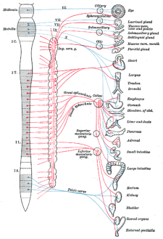
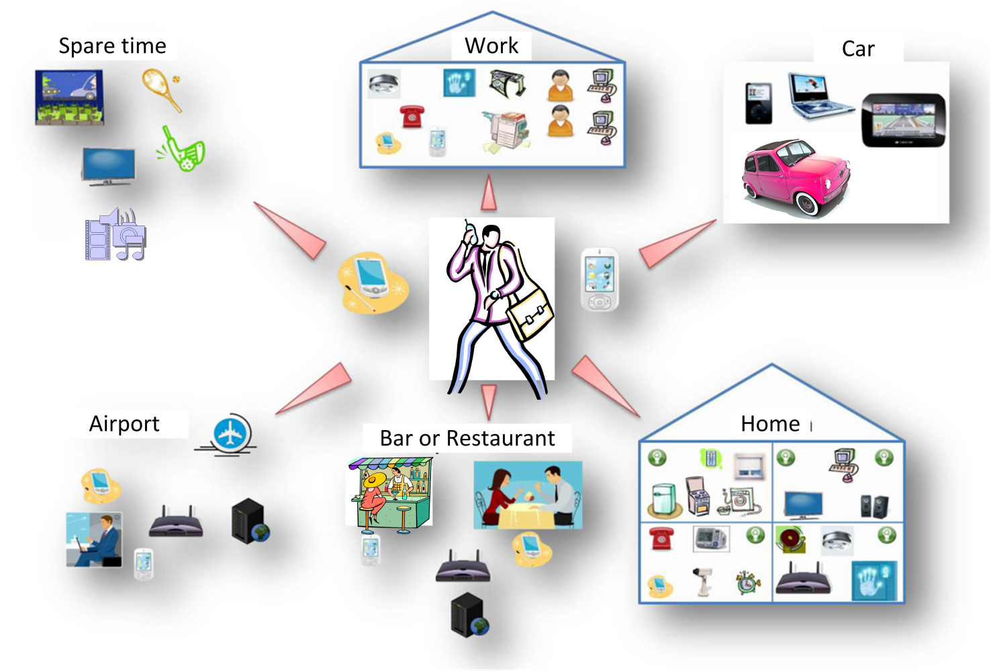
Multiple influences
Biology
Robotics and automatic systems
Bio(socio)-inspired algorithms
AUTONOMIC COMPUTING
Ubiquitous Computing
Ambient Intelligence
Proactive Computing
Software Engineering
Artificial Intelligence and Multi-agent system

Slide 12
Definition: Autonomic computing
  « The essence of autonomic computing systems is self-management, … free system administrators from the details … provide users with a machine that runs at peak performance 24/7 » [Kephart]
  «…realize computer and software systems and applications that can manage themselves in accordance with high-level guidance from humans » [Parashar]
  « The aim [is to] create the self-management of a substantial amount of computing function to relieve users of low level management activities … The vision of autonomic computing is to create selfware through self-* properties» [Sterritt]
Autonomic computing is the field interested in all
adaptive technologies to provide approaches and tools for building self-managed systems, called autonomic systems

Slide 13
Autonomic System
An autonomic system has sufficient information on its environment and itself to be able to anticipate the situations they encounter and to adapt to it in order to deliver its services in the best possible way with respect to the high-level policies fixed by the administrator
Self-Configuration
Self-Optimisation
Self-Healing
Self-Protection
Self- …

Slide 14
Building an autonomic system is hard (1/2)
expert
Absorb complexity
Deal with different goals
  Resource management
  Self-healing
  Self-optimization
  Business specific goals…
Dynamic and fluctuating environments
  Communication with other managers
  Managed element modifications
M
A
N
A
G
E
R
“Lower CPU consumption”
Z=3
GOALS
Administrator
Z=3

Slide 15
Building an autonomic system is hard (2/2)
expert
They should be
  Reliable
  Maintainable
  Administrable
  Adaptable
  Extensible
M
A
N
A
G
E
R
“Lower CPU consumption”
Z=3
GOALS
Administrator
Z=3
As most systems … may be more than others!

Slide 16
Outline
Autonomic Computing
  Definition
  Autonomic system’s architecture
Proposition
CEYLAN’s architecture
Validation
Conclusion

Slide 17
The control loop
Monitoring
Decision
Action
M
A
N
A
G
E
R
“Lower CPU consumption”
GOALS
Z=3
Administrator

Slide 18
Generally accepted structure of autonomic systems
An autonomic element consist in
  One or more managed elements
  Touchpoints
  An autonomic manager
Goals
Feedback
Autonomic Manager
sensors
effectors
Managed Element

Slide 19
Organisation and choices
Management architecture
  One or many autonomic subsystems?
  Centralized/Distributed/Hierarchical
Manager architecture
  Monolithic/modular
Technologies
  Rules, component, services…

Slide 20
Monolithic
Black (red!) box: rules or code
Goals
Monitoring
Exécution
Autonomic Manager
sensors
effectors
Managed Element

Slide 21
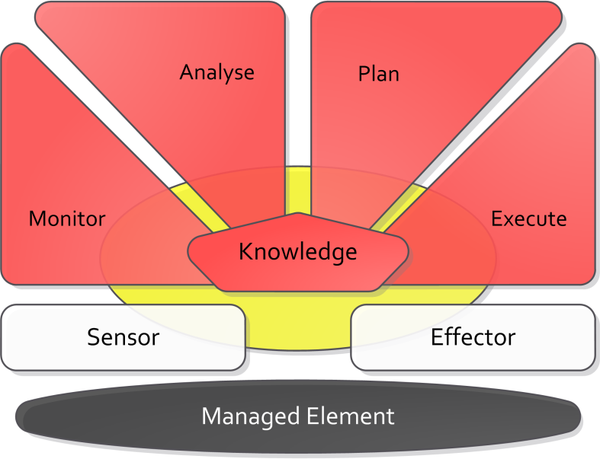
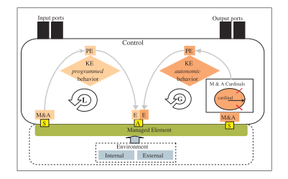
Modular
IBM’s MAPE-K
Parashar, Hariri…
Goals
Goals
MAPE-K like

Slide 22
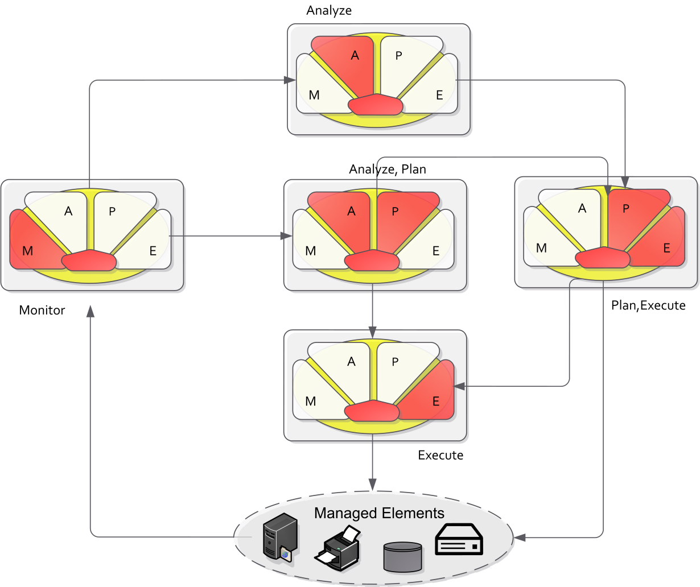
Pieces of managers (Sweitzer, Draper)
only general principles - a design pattern, insufficient in itself.

Slide 23
Chain of responsibilities
Goals
A
P
Mediation
Framework,
Monitoring frameworks…
M
K
E
Autonomic Manager
sensors
effectors
Managed Element

Slide 24
Projects
Project | Internal Architecture | Management Architecture | Technologies
Rainbow | Modular (MAPE-K like) | Centralized | Rules
Jade | Modular (MAPE-K) | Centralized | Code
Unity | Modular (MAPE-K) | Distributed | Utility function
Autonomia | Modular static (MAPE-K) | Distributed | Rules
Automate | Modular | Distributed | Component(Agent)/Rules
Auto-Home | Monolithic | Hierarchical | Code

Slide 25
Projects
Project | Internal Architecture | Management Architecture | Technologies
Rainbow | Modular (MAPE-K like) | Centralized | Rules
Jade | Modular (MAPE-K) | Centralized | Code
Unity | Modular (MAPE-K) | Distributed | Utility function
Autonomia | Modular static (MAPE-K) | Distributed | Rules
Automate | Modular | Distributed | Component(Agent)/Rules
Auto-Home | Monolithic | Hierarchical | Code

Slide 26
Conclusion: Curent framework and architecture
Excellent logical architecture (MAPE-K)
However
  Sometimes hard to implement
    too constraining
    do not separate different concerns/goals
    coarse-grained architectural blocks
    frequently implemented as rules or coarse-grained components with negative consequences on maintenance or poor dynamism/reusability
  Hard to extend
  Hard to reuse

Slide 27
Limitation
Dynamicity:
  The possibility of changing dynamically the internal architecture of managers is often ignored
  MAPE-K does not provide guidance on how to manage dynamism between modules
  Rules: hard to predict/understand/maintain (fine-grained)

Slide 28
Proposition

Slide 29
Goals
Ease the development, maintenance and evolution of autonomic managers
Building a framework that
  Supports reusing of common/redundant functionalities
  Provides a homogeneous and dynamic model for the integration of autonomic functions
  Promotes the reuse of autonomic functions
  Allows different management concerns to be implemented in isolation
  Facilitates the evolution and extension of manager’s behaviour at runtime

Slide 30
Proposition
Decompose the manager behaviors into elementary activities: administration tasks
disable
Managed System

Slide 31
Proposition
Decompose the manager behaviors into elementary activities: administration tasks
Each path = one control loop
disable
Managed System
enable
MAPE compliant

Slide 32
Example: CPU Management
  A: CPU monitoring
  B: Average CPU usage
  C: Threshold detection
  D: Decision (Switch to CPU friendly algorithm)
  E: Apply decision
B
disable
Managed System
enable
A
C
D
E

Slide 33
Dynamic opportunistic cooperation
Composition is opportunistic and depends on the runtime context
C
O
N
T
E
X
T
Managed System

Slide 34
Dynamic opportunistic cooperation
Composition is opportunistic and depends on the runtime context
C
O
N
T
E
X
T
Managed System

Slide 35
Dynamic opportunistic cooperation
Composition is opportunistic and depends on the runtime context
C
O
N
T
E
X
T
Managed System

Slide 36
Dynamic opportunistic cooperation
Composition is opportunistic and depends on the runtime context
C
O
N
T
E
X
T
Managed System

Slide 37
Extensibility/Adaptation
Task can be removed or deployed/added new task anytime
C
O
N
T
E
X
T
Managed System
Task repository

Slide 38
Non-functional aspects
A task should be easy to develop
  The framework should deal with non-functional concerns
A task must be
  Manageable
  Discoverable and deployable at runtime
  Dynamically activable/de-activable at runtime
  Reusable
    standard interfaces.

Slide 39
Framework - required functionalities
Integration of tasks:
  Coordination:
    communication
    synchronization of tasks: data, activation
  Conflict management:
    avoid execution of competing tasks
Administration/Management
  lifecycle (discovery, installation, activations…)
  monitoring (number of executions, state, execution history)
  failure detection (one task is blocked)
  User interfaces
Dynamism (repository, deployment at runtime)
Construction

Slide 40
Control of the tasks
A dedicated controller manages tasks lifecycle, conflicts, communication
C
O
N
T
E
X
T
Management of the Task (controller)
Managed System

Slide 41
Control of the tasks
A dedicated controller manages tasks lifecycle, conflicts, communication
C
O
N
T
E
X
T
Communication
Conflicts
Database
Lifecycle
Managed System

Slide 42
Construction and adaptation
C
O
N
T
E
X
T
Administration
Creation
Modifications
Runtime context
Management of the Task (controller)
Managed System

Slide 43
Construction and adaptation
Administrator/expert
High-level goals
Targeted manager (ADL)
Self-Adaptation
HMI / ADL
C
O
N
T
E
X
T
Creation
Modifications
Runtime context
Management of the Task (controller)
Managed System

Slide 44
CEYLAN’s Architecture
  Task architecture
  Control
  Construction/Adaptation

Slide 45
Administration Tasks in detail
Elementary behavior (specialized algorithm )
    monitoring some parameter
    detecting crossing of a threshold
    inferring a value
Administration events
Managed System
Events/data
Non functional concerns
Function

Slide 46
Tasks modular architecture
Separation of concerns
  Communication
  Activation
  Conflict Management
  Statistic
  Functionality specification (type) / implementation
TASK

Slide 47
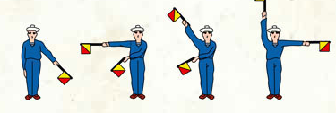
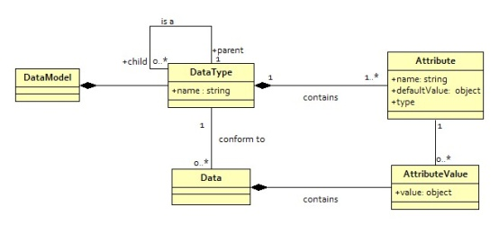
Ports: Communication
Collects and produces data:
  Data are described in a data model
    Dictionary of values with a unique name
TASK

Slide 48
Ports : Communication
Collects and produces data :
  Data are described in a data model
    Dictionary of values with a unique name
Discovery

Slide 49
Scheduler: tasks triggering
Triggering conditions depend on context, including:
  Nature/quantity/values of collected data
  Time interval/certain date/last activation
  Shared information with other tasks
Task is waiting
TASK

Slide 50
Scheduler: tasks triggering
Triggering conditions depend on context, including:
  Nature/quantity/values of collected data
  Time interval/certain date/last activation
  Shared information with other tasks
Task is ready
TASK

Slide 51
Coordinator: Conflict Management
Obtain the necessary authorization to handle data
  Part of the conflict management mechanism
  Only used for potentially conflicting data types
  E.g. Compression task vs Deletion task
Task is ready
TASK

Slide 52
Coordinator: Conflict Management
Obtain the necessary authorization to handle data
  Part of the conflict management mechanism
  Only used for potentially conflicting data types
  E.g. Compression task vs Deletion task
Task is activated
TASK

Slide 53
Processor: Business code
Specialized (business) algorithm
TASK

Slide 54
Statistics
Statistics collection for task evaluation:
  Number of task executions
  Quality and type of data processed/produced
  Average task execution task
  Lifecycle information (blocked task…)
TASK

Slide 55
Administration
Manage task state and lifecycle information

Slide 56
Task Lifecycle

Slide 57
Outline
Autonomic Computing
Proposition
CEYLAN’s architecture
  Task architecture
  Control
  Construction/Adaptation
Validation
Conclusion

Slide 58
Control of the tasks
A dedicated controller manages tasks lifecycle, conflicts, communication
C
O
N
T
E
X
T
Communication
Conflicts
Database
Lifecycle
Managed System

Slide 59
Conflict Management
Several approaches
  By synthesis
  By filtering
  By arbitration
  By negociation
To bring flexibility

Slide 60
Conflict Management
Several approaches
  By synthesis
  By filtering
  By arbitration
  By negociation
To bring flexibility
After execution
Before execution

Slide 61
Conflict Management: By synthesis
Use of specialized task to aggregate/select data

Slide 62
Conflict Management: By arbitration
A special component decides on the task to be activated on which data

Slide 63
Conflict Management: By arbitration
A specialized components decides which task can activate on which data

Slide 64
Conflict Management: By arbitration
A specialized components decides which task can activate on which data

Slide 65
Conflict Management: By arbitration
A specialized components decides which task can activate on which data

Slide 66
Conflict Management: By arbitration
Implementation can be changed dynamically
Token based

Slide 67
Conflict Management: By arbitration
Implementation can be changed dynamically
Priority based

Slide 68
Conflict Management: By arbitration
Implementation can be changed dynamically
Inhibition based

Slide 69
Outline
Autonomic Computing
Proposition
CEYLAN’s architecture
  Task architecture
  Control
  Construction/Adaptation
Validation
Conclusion

Slide 70
Construction
At design time the manager is described in terms of task types
  Describing task functionality
  Fully independent from implementation
At runtime
  Administrator modifies targeted manager model if necessary
  Construction module is responsible for instantiating this model
    Implementation discovery
Targeted Manager (ADL)
Construction Module
Model@Runtime

Slide 71
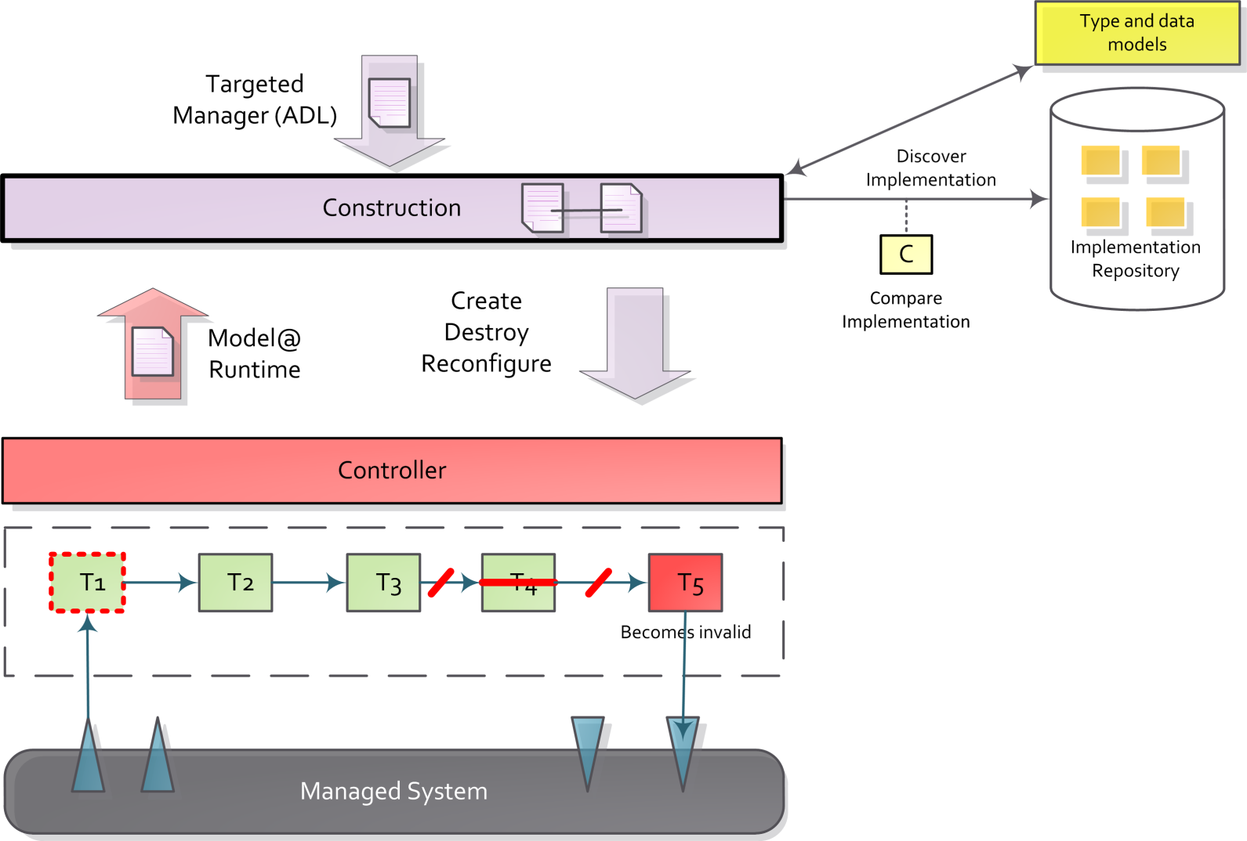
Construction

Slide 72
Adaptation

Slide 73
Validation
  CEYLAN’s implementation
  Application

Slide 74
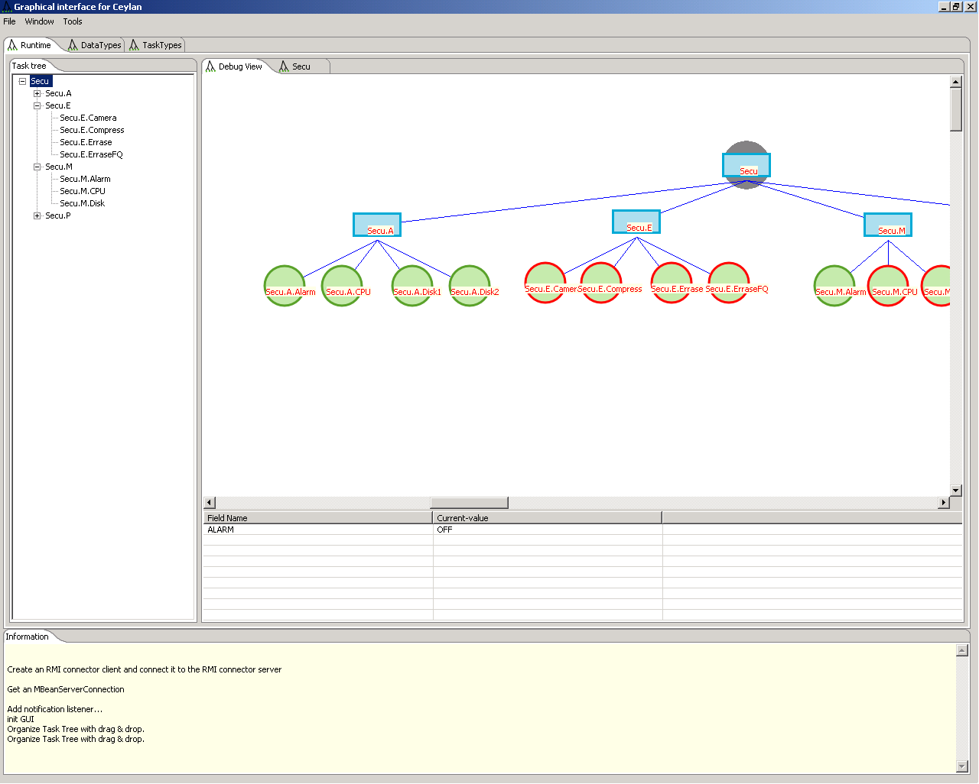
In short
Fully functional implementation
  10000 lines of java code + 6000 for HMI
Extensible implementation of each modules
  Scheduler, port, arbiter…
  Basis for new implementation

Slide 75
Service-Oriented Component Model

Slide 76
XML based ADL
Architecture
Implementation

Slide 77
Administration HMI

Slide 78
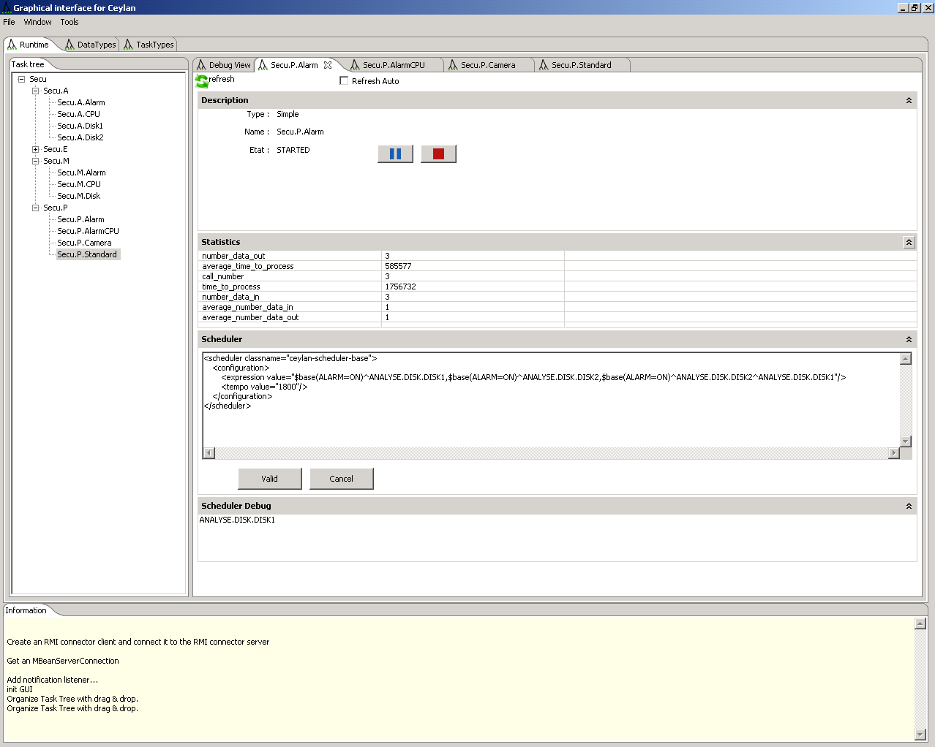
Administration HMI

Slide 79
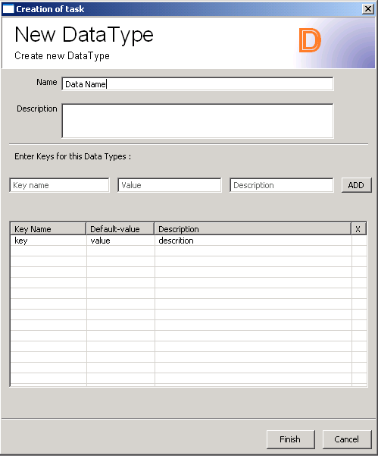
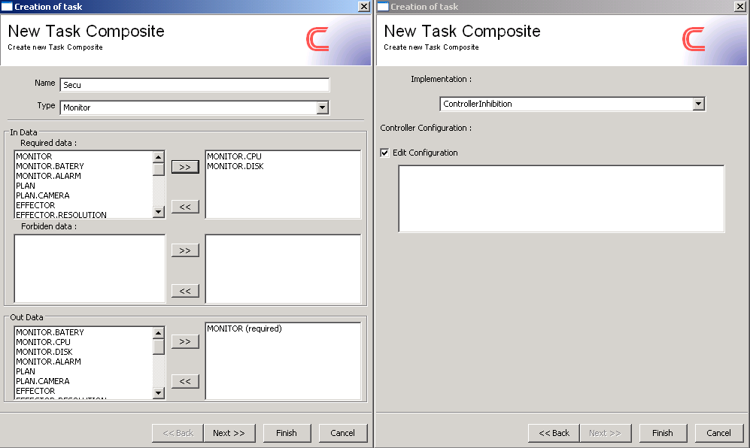
Administration HMI
Assisted creation of tasks, task types and data types

Slide 80
Outline
Autonomic Computing
Proposition
CEYLAN’s architecture
Validation
  CEYLAN’s implementation
  Application
Conclusion

Slide 81
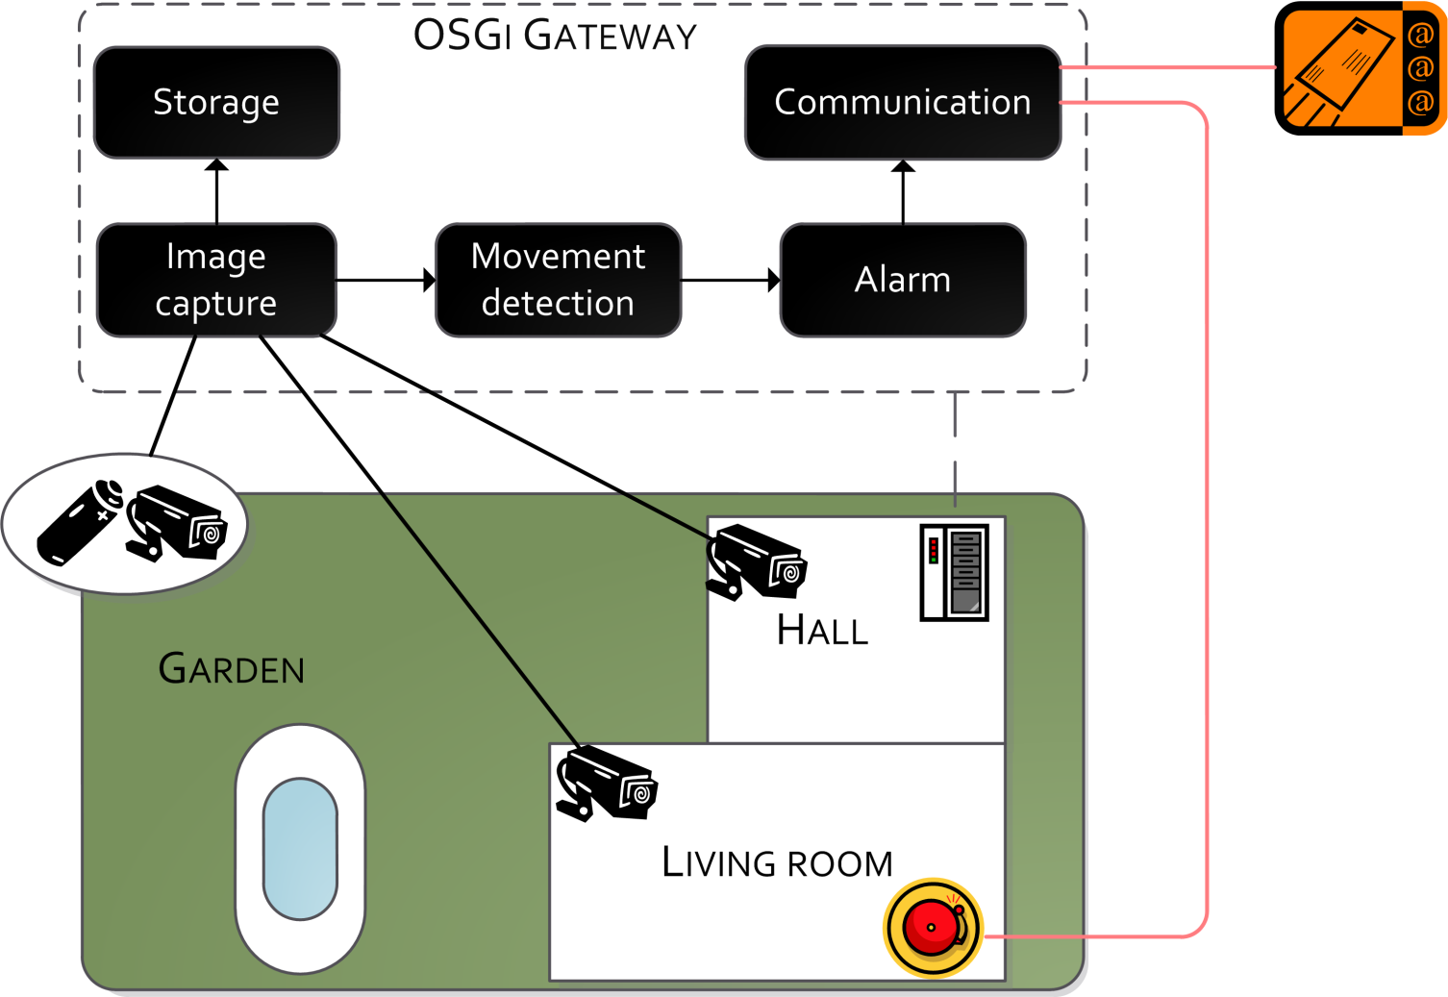
Intrusion Monitoring Application

Slide 82
Various objectives
Goals
  Disk Management
  CPU Management
  Battery Management
  Calibration,…
Progressive construction of the manager by integration of the different concerns
  Implementation in isolation

Slide 83
Non Managed Application
ALARM

Slide 84
CPU+Disk Management
Goal :
  Use less CPU if possible
    CPU friendly detector
  Delete old images from storage

Slide 85
CPU+Disk Management
Goal :
  Use less CPU if possible
    CPU friendly detector
  Delete old images from storage
A
P
A
Intrusion Monitoring
P
M
M
E
E

Slide 86
CPU+Disk Management

Slide 87

Problem: blocked tasks
Solution:
  Replace blocked tasks
A
P
Intrusion Monitoring
M
E

Slide 88

Auto-replaced blocked tasks

Slide 89
We try to use compression
Goal:
  Use compression when effective, erase otherwise
Solution
  Token based arbiter
Arbiter
A
P
Intrusion Monitoring
P
M
E
E

Slide 90
Arbiter
A
P
Intrusion Monitoring
P
M
E
E

Slide 91
More complex behavior
Goal:
  Battery management,
  Alarm management,
  CPU management,
  Cameras…
A
P
A
Intrusion Monitoring
P
P
A
P
M
M
M
E
E
E
E

Slide 92
Combination

Slide 93
Synthesis
Complex and extensible behavior via the combination of tasks
Implementation of the different concerns in isolation
Conflict management via arbitration
20-30% slower than ad hoc MAPE-K
  But dynamic, extensible at runtime

Slide 94
Conclusion

Slide 95
In Short
We introduce a new level of abstraction: task
Manager
Manager
MAPE like
(activities centered)
Monitor
Analyze
Plan
Execute
Task
(function centered)
Code/rules
System.out.println()
If (Foo) then BAR

Slide 96
In Short
Flexibility
Manager
Manager
Composite Task
( activities centered)
M
A
P
E
Task
(function centered)
Code/rules
System.out.println()
If (Foo) then BAR

Slide 97
In Short
Flexibility
Manager
Manager
Composite Task
( activities centered)
M
A+P
E
Task
(function centered)
Code/rules
System.out.println()
If (Foo) then BAR

Slide 98
In Short
Flexibility + Adaptation + Dynamicity + Opportunism
Manager
Manager
Composite Task
( activities centered)
M
A+P
E
Task
(function centered)
Code/rules
System.out.println()
If (Foo) then BAR

Slide 99
Conclusion
  Supports reusing of common/redundant functionalities
    Reusable non-functional tasks modules (scheduler, coordinator, port)
  Provides a homogeneous and dynamic model for the integration of autonomic functions
    Tasks have standard interfaces
    Separation Specification/Implementation
  Promotes the reuse of autonomic functions
    Specialized algorithm
    Adequate granularity

Slide 100
Conclusion
  Allows different management concerns to be implemented in isolation
    One concern = one set of tasks
    Composite tasks
  Facilitates the evolution and extension of manager’s behaviour at runtime
    Task can be discovered/installed/removed dynamically at runtime
    Layered architecture to ease administration

Slide 101
Perspective: IDE
Administrator/expert
High-level goals
Targeted manager (ADL)
Self-Adaptation
HMI / ADL
C
O
N
T
E
X
T
Creation
Modifications
Runtime context
Management of the Task (controller)
Managed System

Slide 102
Perspective: Self Adaptation
Administrator/expert
High-level goals
Targeted manager (ADL)
Self-Adaptation
HMI / ADL
C
O
N
T
E
X
T
Creation
Modifications
Runtime context
Management of the Task (controller)
Managed System

Slide 103
Perspective: Distribution
C
O
N
T
E
X
T
Management of the Task (controller)
Managed System

Slide 104

Questions?

